Slide 1
Help investor to find the most suitable restaurant to invest

Slide 2

Introduction
The stakeholder just came to Vancouver.
He has been to several really good Seafood restaurants.
He wants to invest on one of top Seafood restaurants.
He needs our advice.

Slide 3
Business Problem
The stakeholder has given us a rating list about the restaurants that he has been to.
His ideal restaurant should
have some nightlife spot nearby
be closed to some bus stop or metro stations
have some shopping malls around

Slide 4
Data
Stakeholder's rating
Three potential target restaurants
Nearby venues information

Slide 5
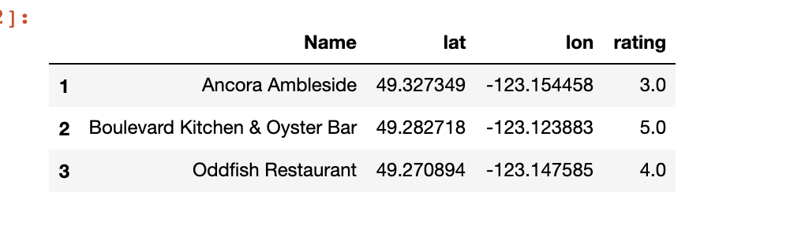
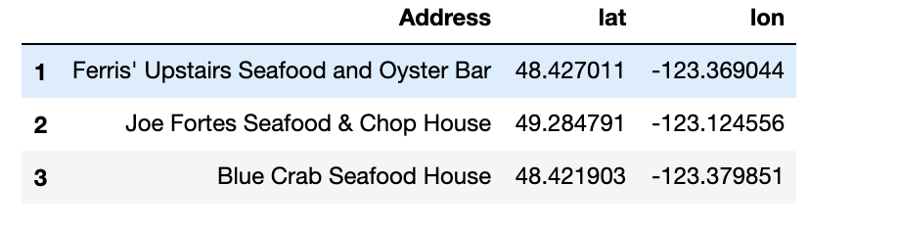
Data that we need
Stakeholder’s rating
The two dataframes can be accessed from OpenTable .
Three potential target restaurants

Slide 6
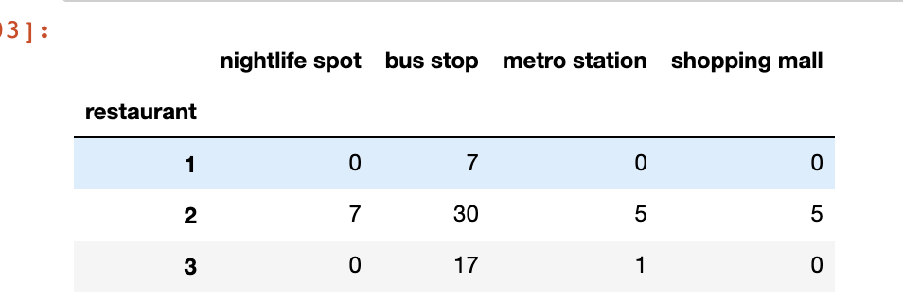
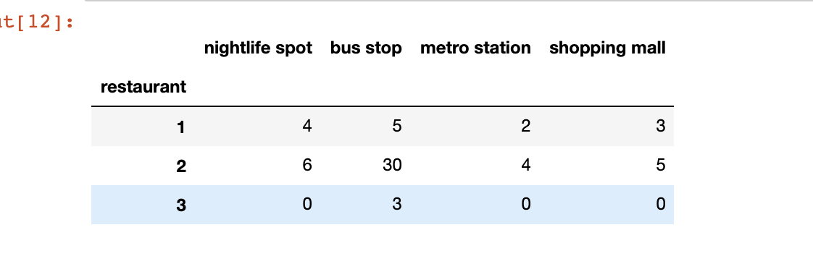
Data that we need
Stakeholder’s choice nearby venues
The two dataframes can be accessed using FourSquare API.
Target restaurant nearby venues

Slide 7
Methods
With the above data, I am able to use the content-based recommendation algorithm.
Stakeholder's rating could be considered as the profile.
Combined with the count of his choice, we can get a weighted feature set for his interest. After the normalization, we will get the user profile.
The user profile can be applied on the 3 candidate information and generate a ranking result. From the ranking result, we can make the final decision.

Slide 8
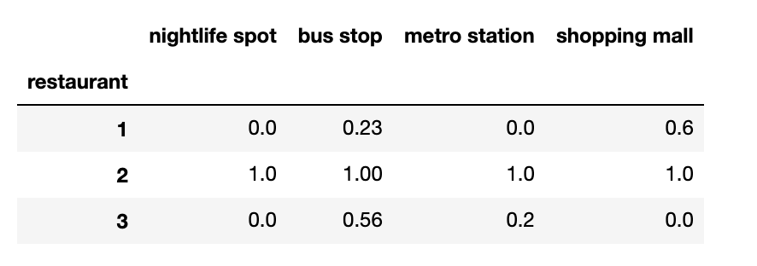
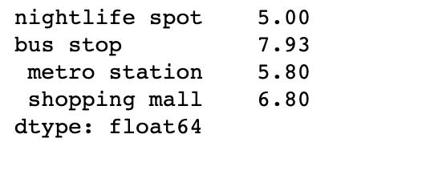
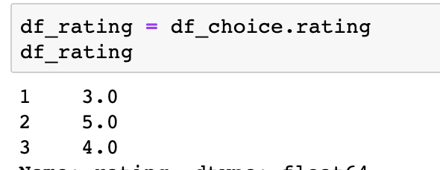
Methods
Using these two data frames, we can get the User Profile.

Slide 9
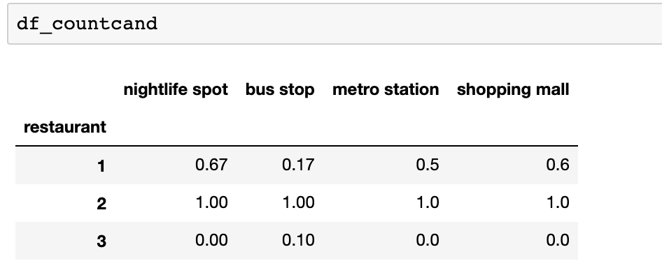
Methods
We apply the user profile to the target restaurants and then we will get the final ratings of targets.

Slide 10
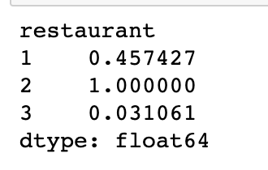
Result
We are able to see that the second target restaurant gets the highest rating. Therefore, we are going to recommend the second restaurant to the stakeholder.

